Slide 1
COMMUNICATION AT WORKPLACE 2 - Interpersonal communication - Barriers to communication
WORKPLACE PROFESSIONAL COMMUNICATION SKILLS

Slide 2
Interpersonal communication

Slide 3
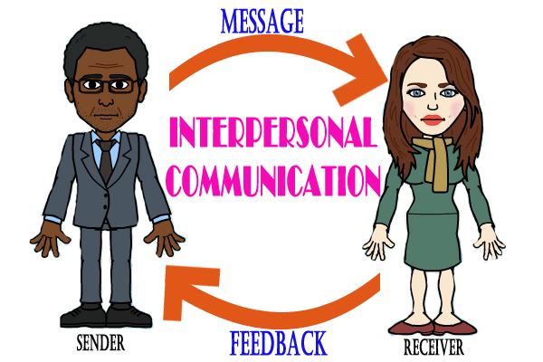
Interpersonal communication

Slide 4
What is Interpersonal Communication?
Interpersonal communication is the process by which people exchange information, feelings, and meaning through verbal and non-verbal means.it is face-to-face communication which often involves hearing, seeing, feeling, body language, facial expressions, and gestures. Interpersonal communication is exchanging information, meaning, feelings, and opinions between two or more people via verbal and non-verbal means. Although we mentioned “face-to-face” communication previously, today’s technology compels us to expand its definition to include media such as phone calls and online messaging.

Slide 5
Types of Interpersonal Communication
Face-to-face conversations: Face-to-face conversations refer to the act of speaking directly with another individual in the same physical space. According to communicative theory, this form of communication allows for a deeper connection and understanding between the two parties involved.
2. Phone/Video calls: Phone/Video calls can mean different things for individuals based on their behavior and strategy. The experience of a phone call vs video call can vary based on one’s ability and comfort level. In the intrapersonal study of communication, phone/video calls play a significant role. The quality of speech and relational competence are key characteristics.

Slide 6
3. Text messaging: Text messaging is a common form of interpersonal communication in today’s digital age. Through text messaging, individuals can communicate with each other in real time, share information, ask questions, and engage in conversations.
4. Social media interactions: Messaging or chatting with friends and family on platforms like Facebook Messenger or WhatsApp. Commenting on a friend’s post on Instagram or Twitter. Sending a direct message to a colleague on LinkedIn. Sharing a post or article with a friend on social media and discussing it through comments or messages

Slide 7
5. Email exchanges: To define interpersonal communication, we must introduce the term as the exchange of messages between people in a contextual setting. Email exchanges differ from other forms of communication, such as impersonal interactions, as they allow us to identify the following techniques for effective communication.
6. Non-verbal cues such as body language and facial expressions: Body language and facial expressions are non-verbal cues that can communicate a lot of information without saying a single word. In fact, research shows that a majority of communication is actually non-verbal. These cues can convey emotions, intentions, and even attitudes. For example, crossed arms may signal defensiveness, while a smile can indicate happiness. It is important to pay attention to these cues in various settings, as they can be just as important as the words we hear.

Slide 8
Must Have Interpersonal Communication Skills
Active Listening
Verbal communication
Nonverbal communication
Empathy
Conflict resolution
Confidence
Respect
Feedback

Slide 9
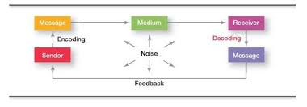
Elements of Interpersonal Communication

Slide 10
Uses of Interpersonal Communication
1. Building and maintaining relationships
2. Resolving conflicts
3. Building trust and rapport
4. Expressing emotions and feelings
5. Sharing information and ideas
6. Negotiating and collaborating
7. Providing support and empathy
8. Influence and persuasion

Slide 11
Barriers to communication
Barriers to communication

Slide 12
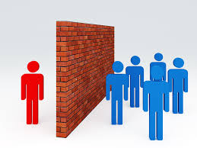
Barriers To Communication Barriers to communication are obstacles that hinder the effective exchange of ideas, messages, or information between individuals or groups. These barriers can occur at any stage of the communication process and can lead to misunderstandings, confusion, or even conflict.

Slide 13
Categorization of Barriers to Communication
1. Physical Barriers
Environmental Factors: Noise, poor lighting, or physical distance can make it difficult to hear or see the communicator, disrupting the transmission of the message.
Technical Issues: Problems with communication tools or technology, such as poor phone signals or malfunctioning video conferencing equipment, can also create barriers.

Slide 14
Categorization of Barriers to Communication
2. Language Barriers
Different Languages: When the sender and receiver speak different languages, communication can become difficult or impossible without translation.
Jargon and Technical Language: Using specialized language, acronyms, or industry-specific terms that the audience does not understand can lead to confusion.
Accent and Dialect: Heavy accents or dialects that are unfamiliar to the listener can make it difficult to understand the message.

Slide 15
Categorization of Barriers to Communication
3. Psychological Barriers
Emotions: Strong emotions like anger, fear, or stress can cloud judgment and affect how a message is sent, received, or interpreted.
Perception and Attitudes: Preconceived notions, stereotypes, or biases can lead to misunderstandings or cause the receiver to misinterpret the message.
Lack of Attention or Interest: If the receiver is distracted or uninterested, they may not fully engage with the message, leading to poor communication.

Slide 16
Categorization of Barriers to Communication
4. Cultural Barriers
Cultural Differences: Different cultural backgrounds can lead to varying interpretations of words, gestures, or symbols. What is considered polite or appropriate in one culture may be seen as rude or confusing in another.
Ethnocentrism: The belief that one’s own culture is superior can lead to misjudging or misinterpreting the messages from people of other cultures.

Slide 17
Categorization of Barriers to Communication
5. Organizational Barriers
Hierarchical Structures: In organizations with strict hierarchies, communication may be impeded by rigid reporting lines, with messages getting lost, delayed, or distorted as they pass through multiple layers.
Information Overload: When too much information is communicated at once, it can overwhelm the receiver, leading to important details being missed or misunderstood.
Poor Communication Channels: Inefficient or inappropriate communication channels can hinder the flow of information, leading to delays or breakdowns in communication.

Slide 18
Categorization of Barriers to Communication
6. Interpersonal Barriers
Lack of Trust: If there is a lack of trust between the sender and receiver, the communication may be strained or dismissed altogether.
Poor Listening Skills: Failure to actively listen can result in missing critical information or misinterpreting the message.
Power Dynamics: Differences in power or authority can create barriers, with one party dominating the conversation or the other feeling intimidated to express their views.

Slide 19
Categorization of Barriers to Communication
7. Semantic Barriers
Misunderstanding of Words: Words can have multiple meanings, and without context, the receiver might interpret the message differently than intended.
Ambiguity: Vague or ambiguous language can leave the message open to various interpretations, leading to confusion.
Overcomplicated Language: Using overly complex or technical language can obscure the meaning and make the message difficult to understand.

Slide 20
Categorization of Barriers to Communication
8. Technological Barriers
Digital Divide: Not everyone has equal access to technology, which can create communication gaps, especially in digital or online communication.
Compatibility Issues: Differences in technology platforms, software, or devices can hinder the effective exchange of information.

Slide 21
Categorization of Barriers to Communication
9. Physiological Barriers
Hearing or Vision Impairment: Physical disabilities, such as hearing loss or poor eyesight, can make communication challenging without appropriate accommodations.
Health Issues: Conditions like fatigue, illness, or stress can affect an individual's ability to communicate effectively.

Slide 22
Categorization of Barriers to Communication
10. Attitudinal Barriers
Negative Attitude: A negative attitude towards the sender, receiver, or message itself can prevent effective communication. For example, if the receiver is sceptical or dismissive, they may not fully engage with the message.
Resistance to Change: If the message involves change, the receiver's reluctance or resistance can be a significant barrier.

Slide 23
Overcoming Communication Barriers

Slide 24

ACTIVITY
Find journal articles which highlights the importance of communication in workplace!

